Slide 1

Python Programming For Beginners
Achala Chathuranga Aponso
MSc Artificial Intelligence (University of Moratuwa),
BSc Software Engineering - First Class Honours (University of Westminster - UK) ,
SCJP, SCWCD, CTHE, SEDA (UK)
President’s Award for the Scientific Research Publication - 2016
Udemy - Teacher / Instructor for 160,200+ students from 100+ countries https://www.udemy.com/user/chathuranga-aponso/
CTHE - Certificate of Teaching in Higher Education , SEDA-UK
Former Software Engineer at WSO2, Cambio & Zone 24x7
PATENT CITATION: NISSAN MOTOR CO., LTD. (Yokohama-shi, JP)
Google Scholar Profile : h-index = 6 , i10-index = 4
LinkedIn: https://www.linkedin.com/in/achalac/

Slide 2
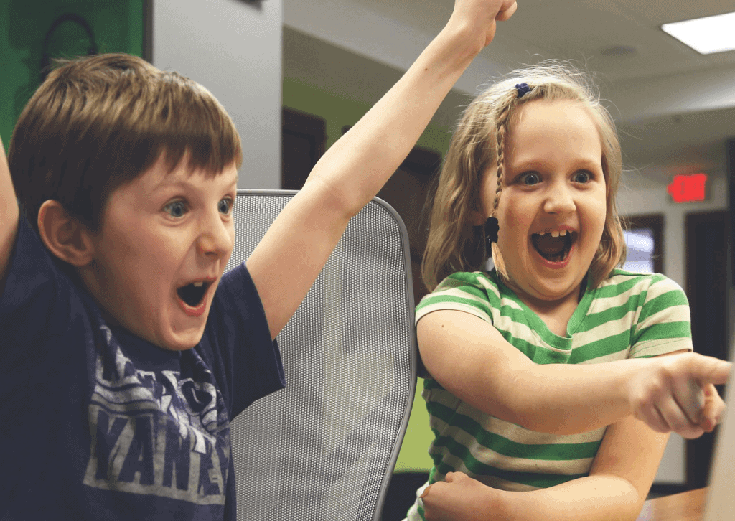
Reasons why every child should learn to code
Programming helps children learn to problem-solve

Slide 3
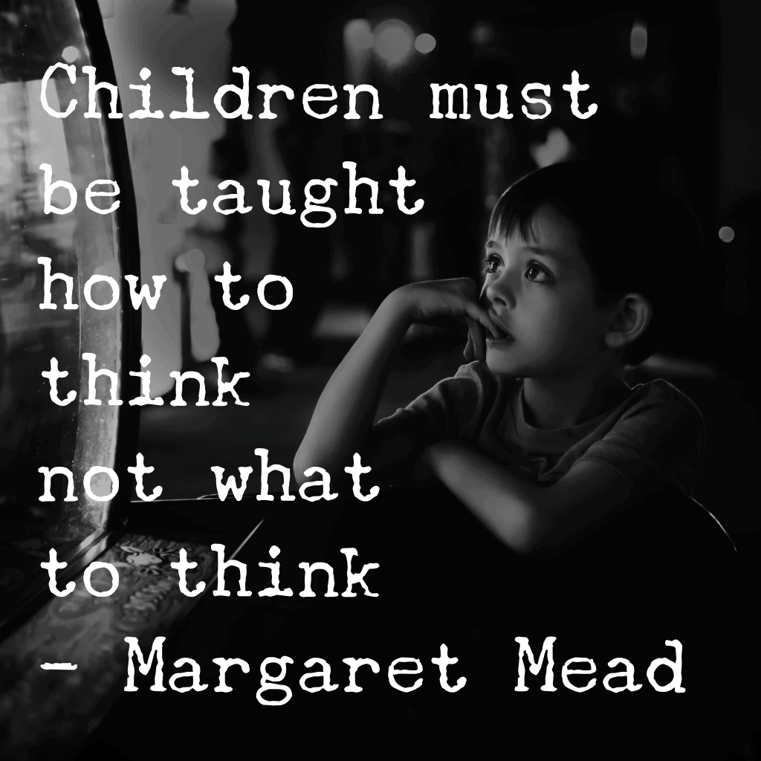
Coding teaches children how to think

Slide 4

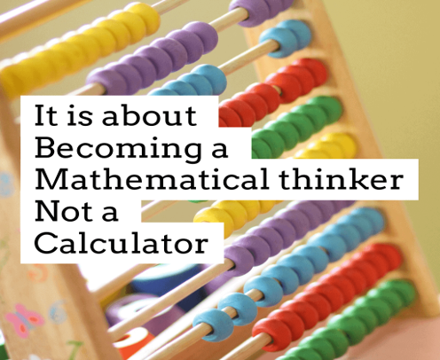
Computer programming is the future

Slide 5
Coding is learning while having fun
If you want to give your child something enjoyable to do which will also be educational and help them to learn, learning to code is the perfect gift.
You can read about the reasons why coding is important, but one of the main ones is to give them a challenge while having fun!

Slide 6
What is coding
Put simply, Coding is the method of communicating with a computer. It is using a language that a computer understands to give a computer instructions in order to perform specific functions. Coding allows us to create things such as computer software, websites, apps and video games.

Slide 7
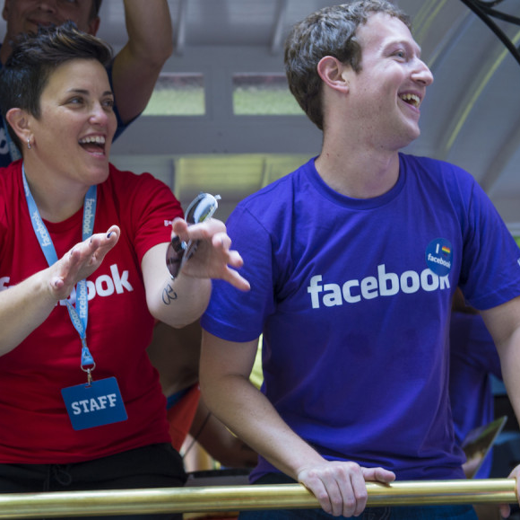
Quote: “All of my friends who have younger siblings who are going to college or high school - my number one piece of advice is: You should learn how to program.”
Coding Fact: Mark Zuckerberg was not only a talented coder as a kid was but an excellent fencer.

Slide 8
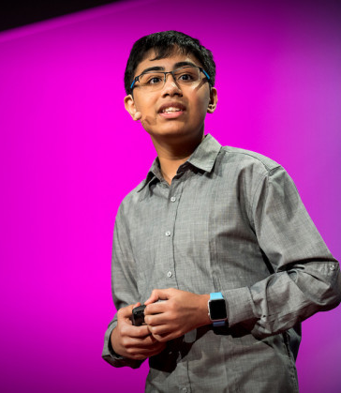
Tanmay Bakshi
Age: 15
Quote: “You have to be passionate about programming before you can program.”
Coding Fact: Tanmay Bakshi has given a TedTalk on his love for programming.
Another young and famous programmer, Tanmay Bakshi, caught the world’s attention and for a good reason. Not only is Tanmay a software developer, but he is an author, speaker, Youtuber, and the world’s youngest IBM Watson developer. The young talent began his programming career at the age of five,
https://interestingengineering.com/7-famous-computer-programmers-who-started-programming-at-an-early-age

Slide 9
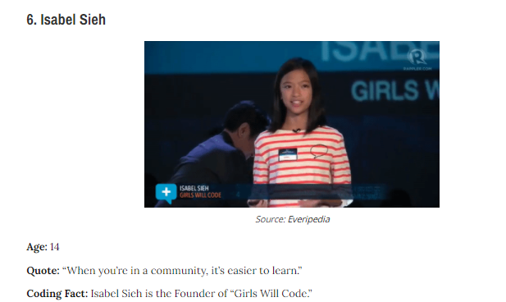
The Filipino-American teenager began her coding journey at the age of 10. This love for coding initially started when she quickly discovered how much she loved math

Slide 10
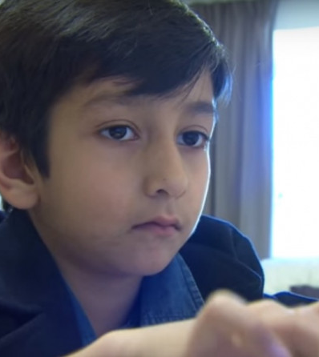
Age: 9
Quote: “I want to be Bill Gates.”
Coding Fact: Muhammad Hamza Shahzad is currently the youngest coder in the world.
The nine year-old British Pakistani from Birmingham, UK, Muhammad Hamza Shahzad discovered his passion at an early age, becoming one of the youngest accomplished programmers in the world. Starting at the age of six,

Slide 11
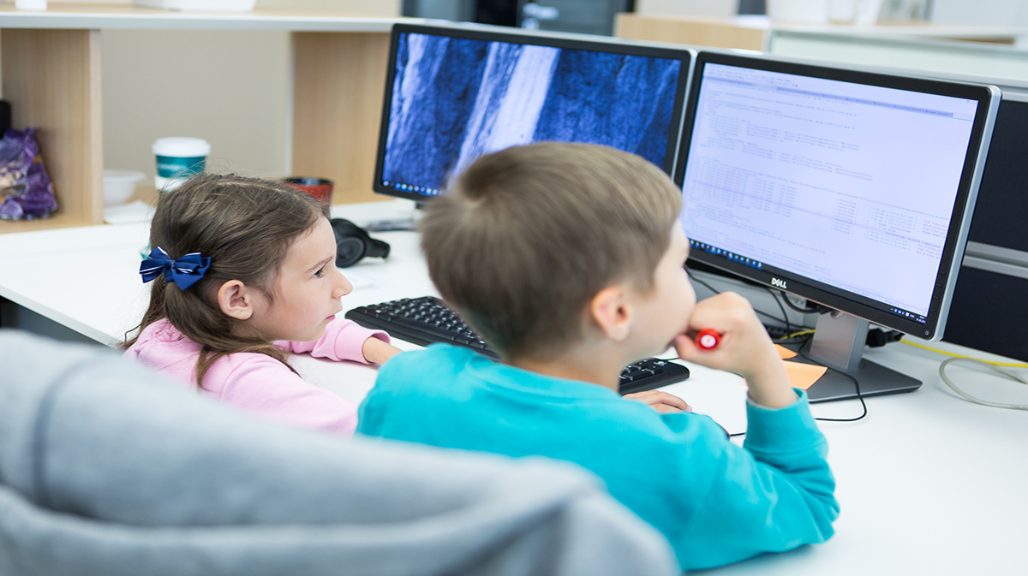

Slide 12
Class : Description
An introduction to computer programming in a high-level programming language.
fundamentals of programming and algorithm design.
Basic coding structures such as sequence, selection, and iteration will be covered. There will be an emphasis on practical exercises to develop programming experience and confidence.

Slide 13
Content for the classes (Based on the speed of students)
Problem Solving & Programs
Introdution to flow charts & Algorithms
Setting up the environmment for python prograaming
Variables
Bult-in functions
Inputs
Conditions
Loops
String
Reading and writing files
Problem Solving & Programs •Values, Types and Variables •Assignment Statements •Arithmetic Operators •Program Comments •Order of Operations •String Operations

Slide 14
https://funtech.co.uk/latest/13-reasons-why-every-parent-should-encourage-their-child-to-learn-coding-skills

